Slide 1
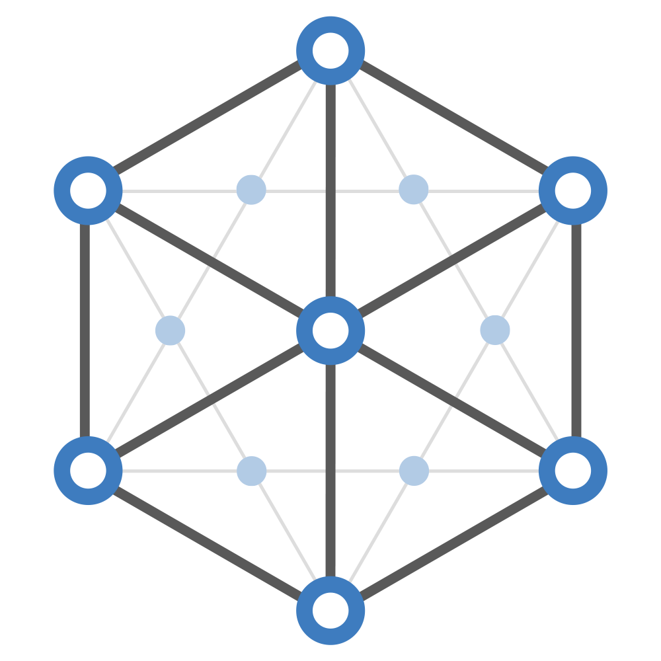

Trusted Data Sharing Platform
For cross-organisational collaboration
TRUSTED DATA SHARING PLATFORM
Notes:
,

Slide 2



The Challenge: cross-organisational collaboration
Public sector organisations need to share citizen information to complete many common transactions. Doing this is difficult because of concerns over data privacy and confidentiality, and a lack of tools to allow data to be shared with confidence.
Nowadays citizens expect a joined-up experience when interacting with their government. They are often frustrated by having to revert to paper, uploading documentation and providing evidence that already exists in other public sector organisations.
Demand for digital citizen services is increasing, especially with the need for reducing in-person services. Resolving data sharing issues must leverage existing investments. New IT solutions must easily connect current systems, not replace them.
TRUSTED DATA SHARING PLATFORM
Notes:
,

Slide 3

The Solution: A Trusted Data Sharing Platform
The SICCAR platform provides the means of creating a trusted data sharing network.
Compliance is built in to every process through a set of agreed rules that are implemented programmatically. Every organisation must follow these rules, and can have confidence that every other organisation involved in the process follows them too. Data is encrypted by default and an immutable register of the entire process is created for accountability and auditability. Data can be shared without being over exposed, as each organisation only sees the information that they require to complete their part of the process.
By safely connecting public sector organisations, the platform can streamline citizen services. Citizens only need to provide their information once, and their eligibility for other services can be carried over without them having to repeat the process. This takes complexity away from the citizen while reducing administration costs for public sector organisations by reducing the work required to achieve regulatory and organisational compliance.
SICCAR offers a unique way of adding value to existing systems, with minimal further investment. Our incremental approach to securely connecting current systems and processes reduces the risk associated with the adoption of new IT, whilst delivering efficiency gains.
TRUSTED DATA SHARING PLATFORM
Notes:
,

Slide 4



The Solution: A Trusted Data Sharing Platform
Models real-life
business processes
Collaboration needs can
be met irrespective of
process complexity, and
the network can be
flexible to changing scale
and requirements.
Consent-based
data protection
As well as allowing
control over your own data,
SICCAR adopts a minimum
disclosure model. This
reduces risk of
non-compliance through
data breaches.
Secure by design
Unlike many other
platforms, security
requirements and
granular permissioning
of data can be built into
processes easily - reducing
risk, cost and time.
System integration
and deployment toolkit
SICCAR integrates with existing
systems, including ID
services. Effective customised
cross-organisational
processes can be built
quickly and cost-effectively.
TRUSTED DATA SHARING PLATFORM
Notes:
,

Slide 5






Simplifying the student funding process
SICCAR has been used to reduce administrative burden involved in claiming student funding, especially for disadvantaged groups.
Entitlements and personal data are stored in a student’s digital wallet and reused for multiple entitlement applications with public sector bodies who the student provides permission to share data with, saving both parties admin cost and time.
Connecting the medical and voluntary sector
SICCAR provides an innovative data-sharing framework to enable effective dietary support and monitoring at home.
This solution lets hospital dieticians share confidential patient information with a voluntary sector service provider, ensuring patients’ nutritional support is coordinated with their discharge from hospital alongside continuous monitoring and recording of the patient’s progress when at home. This enables the NHS and voluntary care organisations to collaborate better and improve patient health and wellbeing, resulting in significant cost savings for the NHS.
Investigating distributed ledger for Scotland
Scottish Government’s Digital Directorate committed to exploring Distributed Ledger Technology’s potential and to sharing best practice with progressive international governments. SICCAR, in partnership with the Scottish Government, conducted international and local research into the application of DLT in digital public services.
The overarching recommendation of the research report is that Scotland join the international ecosystem as an active participant, and develop a Scottish vision together with universities and businesses.
TRUSTED DATA SHARING PLATFORM
Notes:
,

Slide 6


Contact:
info@siccar.net
+44 131 460 7768
Learn more at: www.siccar.net
TRUSTED DATA SHARING PLATFORM
@SiccarNet
/SiccarNet
Notes:
,

